Slide 1
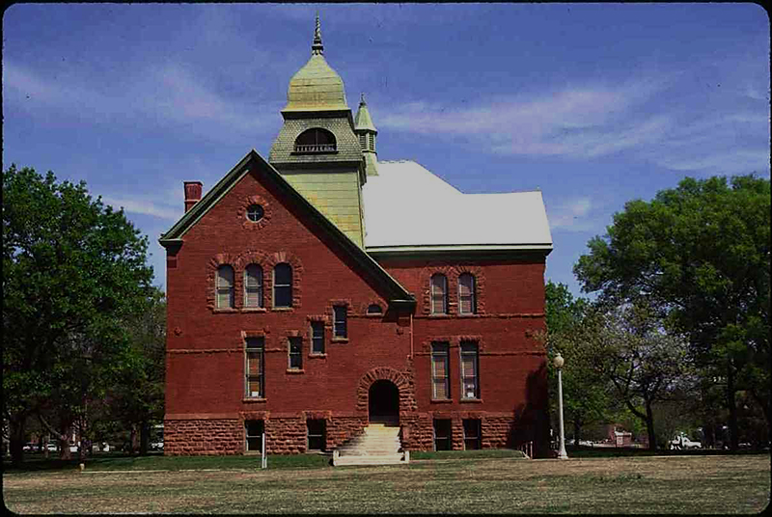
Budget Development
Entry in
Self Service Banner

Slide 2
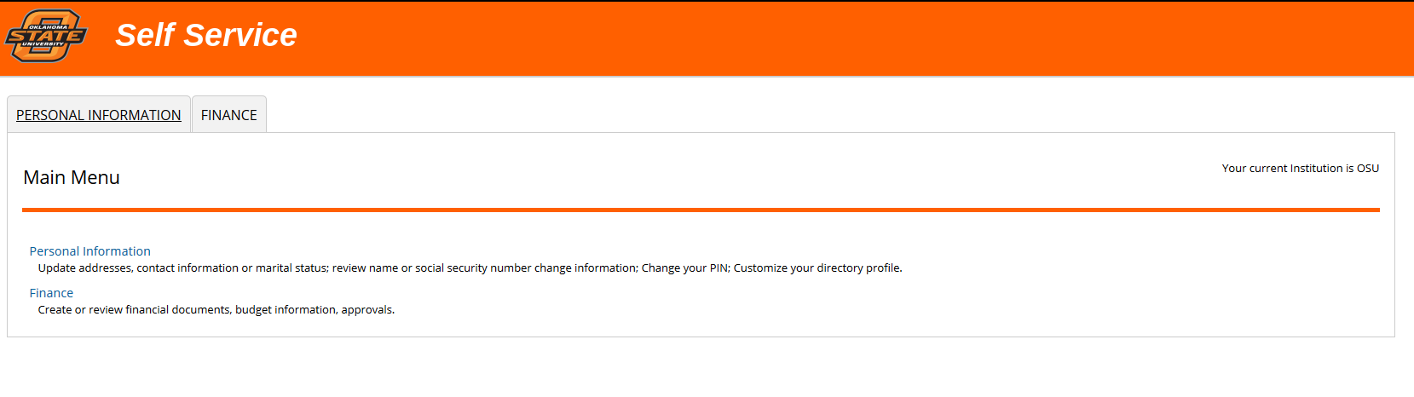
Login to Self Service Banner; select Finance.

Slide 3
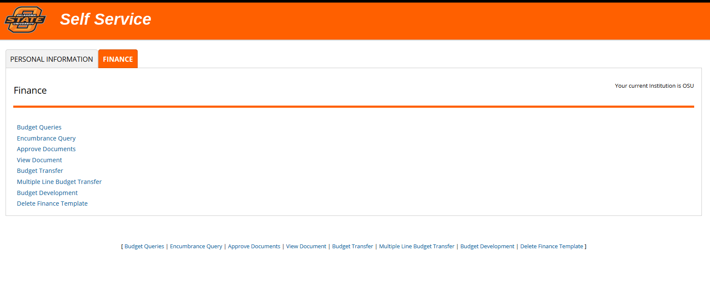
Select Budget Development.

Slide 4
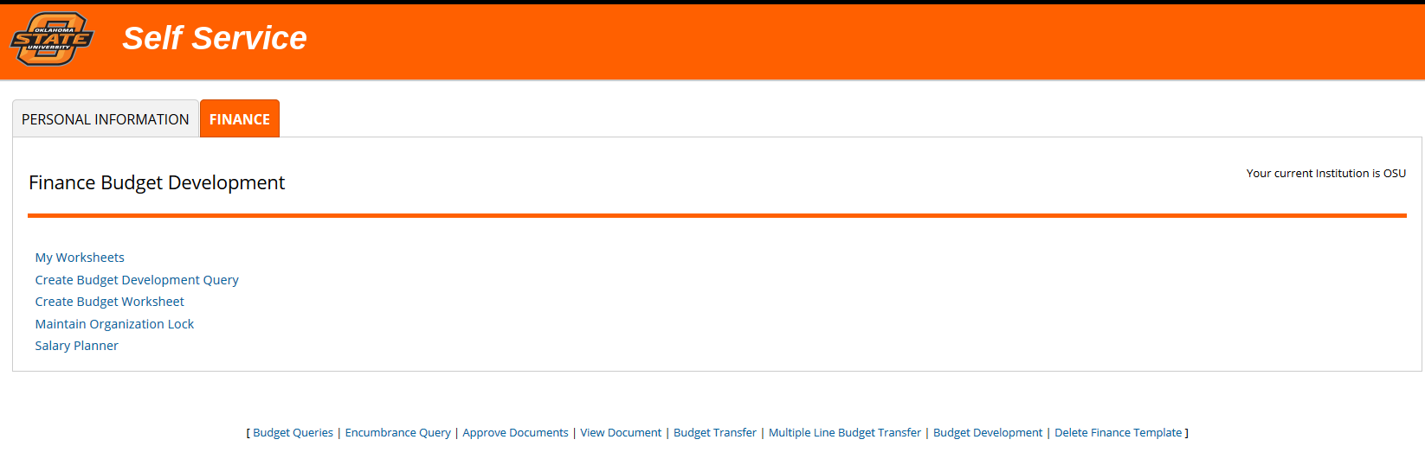
Create Budget Worksheet

Slide 5
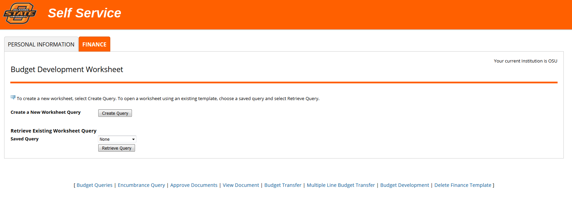
Create a New Worksheet Query.

Slide 6
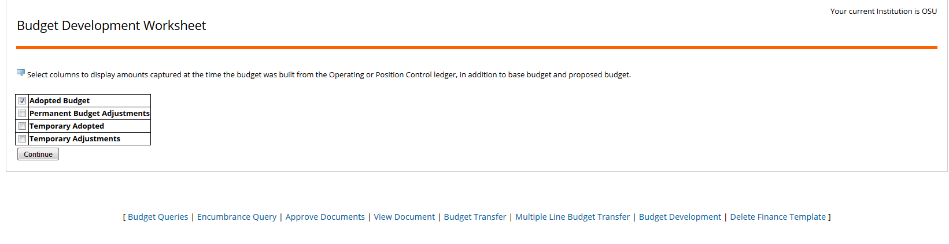
Select Adopted Budget; this will be your Prior Fiscal Year Adopted Budget. Click Continue.

Slide 7
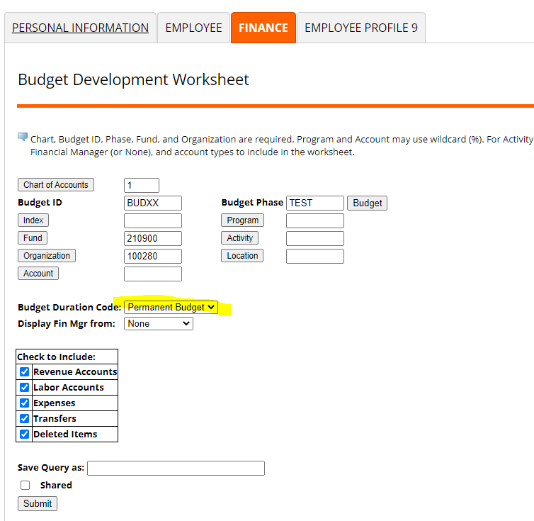
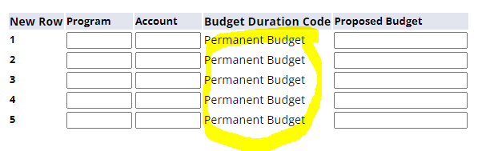
Enter Chart of Accounts, Budget ID, Budget Phase, Fund, and Organization. University Budget will provide you with the Budget ID and Budget Phase. Select all account types in check boxes (Revenue, Labor, Expenses, Transfers, and Deleted Items).
If the Budget Duration Code shows “All”, change to “Permanent Budget”. This will hard default into the worksheet.
Click Submit.

Slide 8
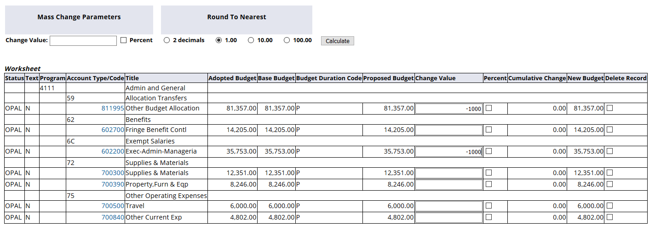
Enter the amount of change in the Change Value field. In this example, we are reducing the total budget by $1,000.00.

Slide 9
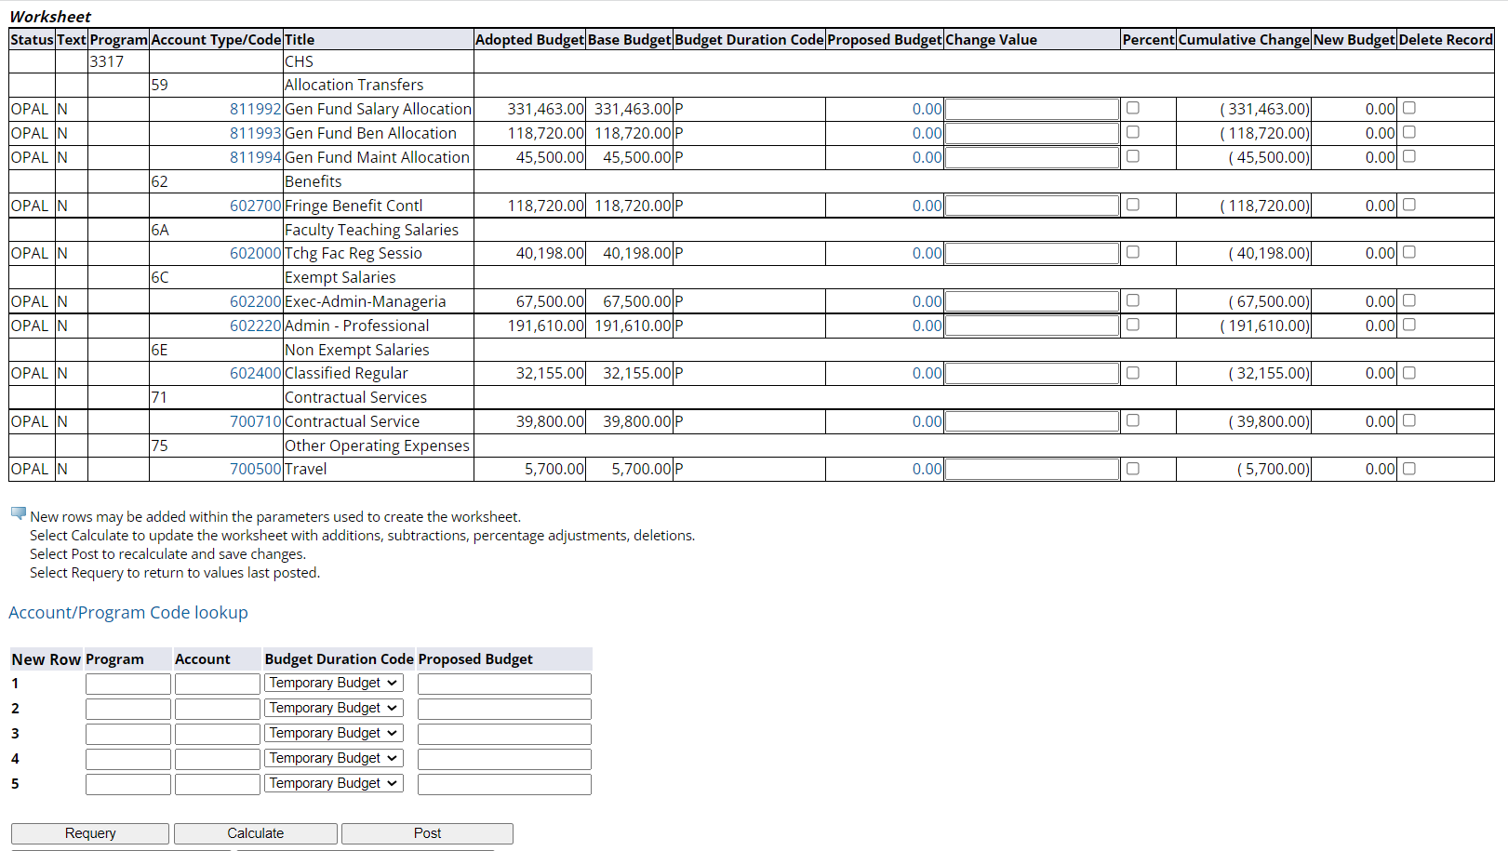
Proposed Budget is what will be loaded into the new fiscal year. Pressing Enter will update Cumulative Change and New Budget and allow you to review amounts, but Proposed Budget will only update once you click Post.

Slide 10
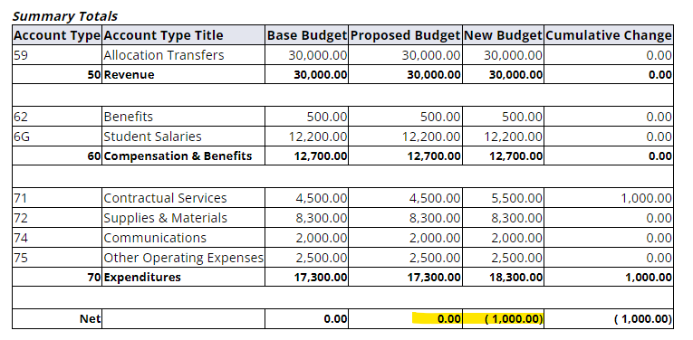
The Summary Totals at the bottom of the screen will show whether or not the fund is in balance. Total Revenues should equal total Expenses.

Slide 11
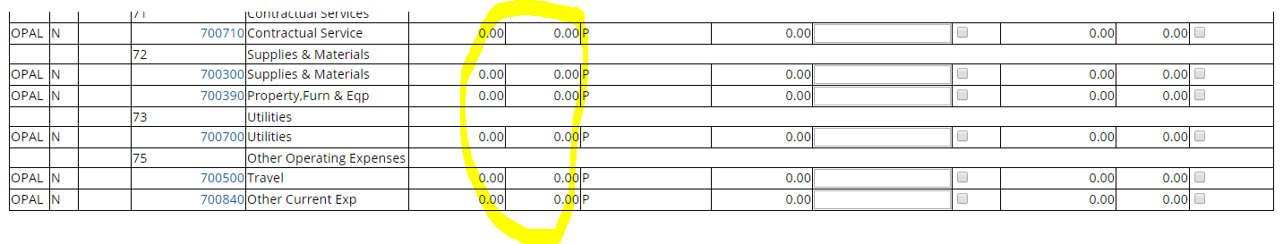
If you see account codes with ZERO Adopted and Base Budget, this means they were not budgeted during last year’s budget cycle. However, there has been budget activity during the current fiscal year, so you need to determine if they should be budgeted for next year. *Note for Chart 1: This does NOT apply to 811993 and the associated benefits account codes.

Slide 12
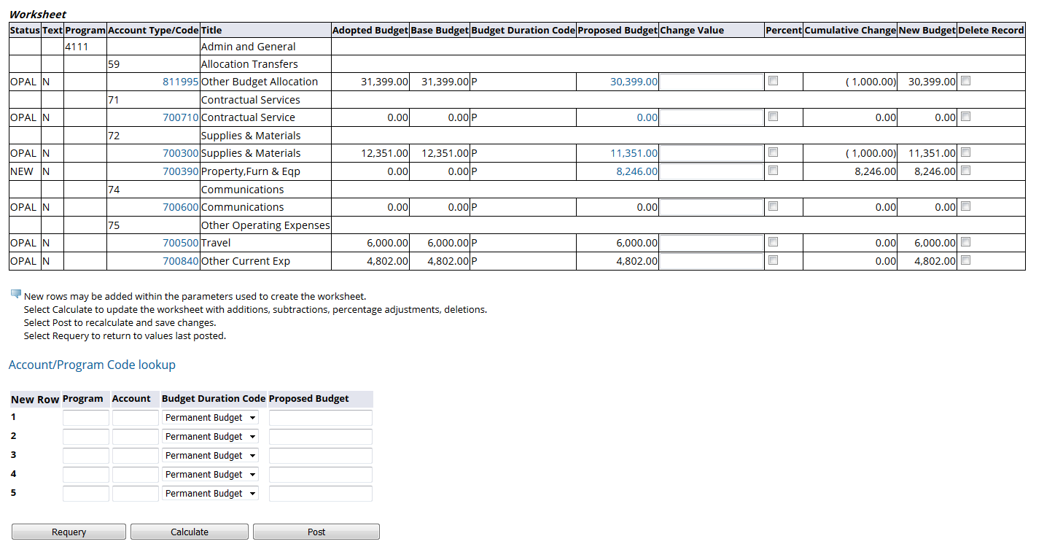
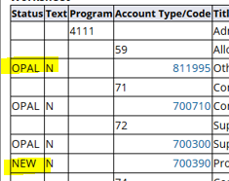
Revenue and expense accounts may be added using the section below the budget worksheet. Program will be the program code for the fund; for this fund it is 4111.
You can see which account codes are part of the current FY
original budget (OPAL), and which have been newly added in Budget
Development (NEW) by looking at the Status column.
Budget Duration Code needs to be PERMANENT BUDGET.

Slide 13
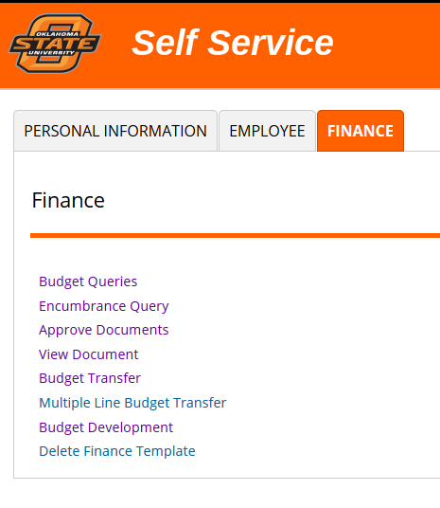
If you are establishing budget on a new fund, you will need to know the program code. This can be found a couple of ways. One way is to run a budget query in Self Service Finance (NOT the Budget Development Query).

Slide 14
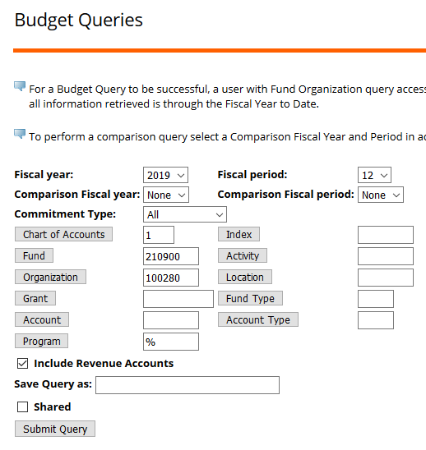
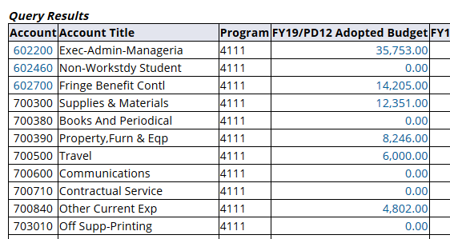
When entering the query parameters, enter the % wildcard in the Program field. Click Submit Query. The query results will show the program code for that fund.

Slide 15

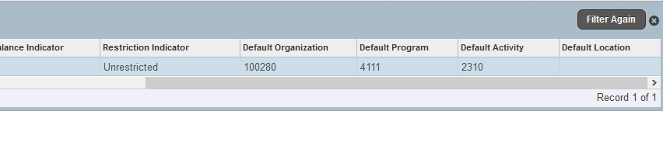
If you are in Banner Administrative, you can also find the program code on FTMFUND. Select the Filter to the far right, enter the Chart and Fund, and select Go.
If the fund information is in list form, you will need to scroll to the far right to see the program code.

Slide 16
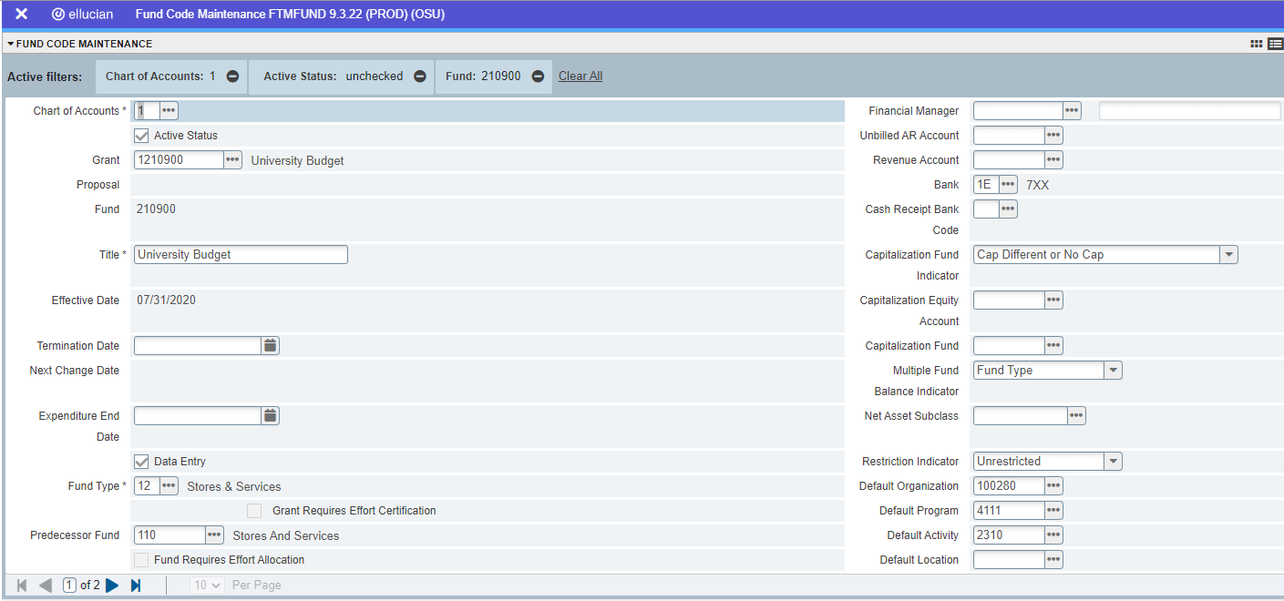
If the fund information is in single record form, the program code will be near the bottom right of the page.

Slide 17
My Worksheets may be used to view a listing of your Budget Worksheets.

Slide 18
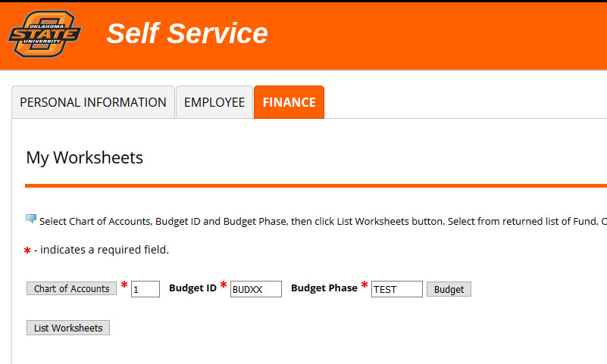
To view a listing of your Budget Worksheets, enter Chart of Accounts, Budget ID, and Budget Phase; click List Worksheets.

Slide 19
The listing will show Fund, Organization, and Program. Select a fund using the radio button to the left; only one fund at a time may be selected. Click Submit.
If you work with more than one Chart, the FIRST Chart you start working will be the only one that populates in My Worksheets. If you choose to use this function, we recommend you start with the Chart you use most so those funds will be listed here.

Slide 20
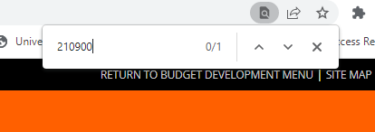
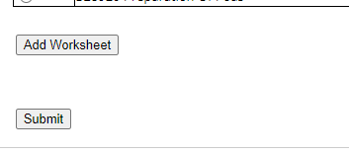
If you have a large list of funds, you can jump to the fund you want by hitting Ctrl + F to bring up a search. Enter the fund you want to view.
Hit the Enter key, and the search will take you to the fund in the search.
Once you select the radio button, hit Ctrl + End and it will take you to bottom of the page. Select Submit.

Slide 21
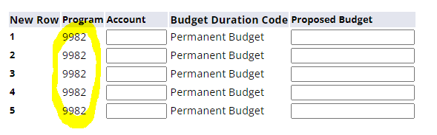
Using My Worksheets to pull up a budget worksheet will cause the program code to hard default in the section used to add account codes.
This helps alleviate accidentally adding an incorrect program code to a fund.

Slide 22
You can also select Create Budget Development Query to view and download budget information.

Slide 23
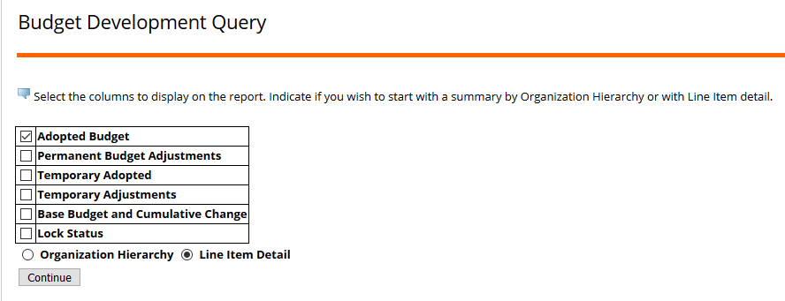
Select Adopted Budget and the Line Item Detail radio button. Click Continue.

Slide 24
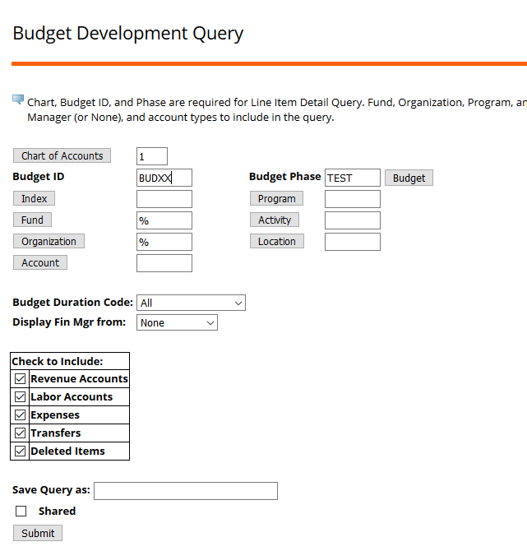
Enter Chart of Accounts, Budget ID, Budget Phase, Fund, and Organization. To look at multiple funds/orgs, you can use the % wildcard. Check the boxes next to the account types you want to view (Revenue, Labor, Expenses, Transfers, and Deleted Items). Click Submit.

Slide 25
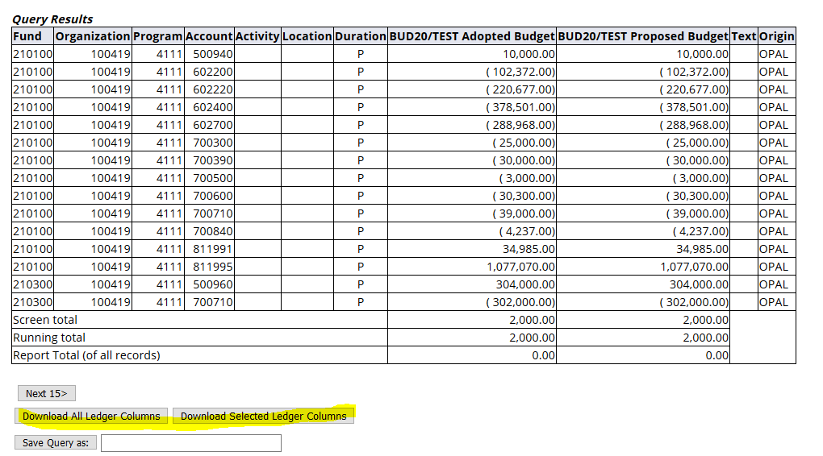
You can page through the query results onscreen or download them into a spreadsheet. The download will provide more information than what appears onscreen and can be sorted/filtered, so this may be preferable.

Slide 26
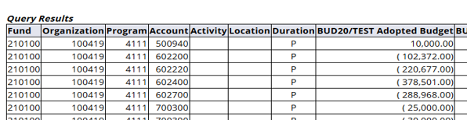
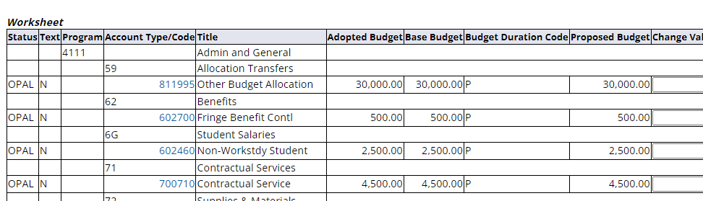
However, be aware if you are looking at the Duration Code, it will NOT appear on the spreadsheet download. You will only be able to see this on the Budget Development Query screen or on the Budget Worksheet.

Slide 27
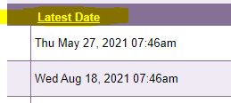
Budget Development Reports
Reports are located in the ePrint repository of each Chart.
The character at the end of the report name represents the Chart,
i.e. FI_BD_BDSCHK01_1 is for Chart 1 and is in the Finance 1 repository.
Some reports will show errors that must be corrected, others are advisory reports.
Be observant of the run date; it will be the latest date there is output.
Example: If there was a May 1 report but nothing May 2, the latest date will be
May 1. This means whatever was on the May 1 report has been corrected.

Slide 28
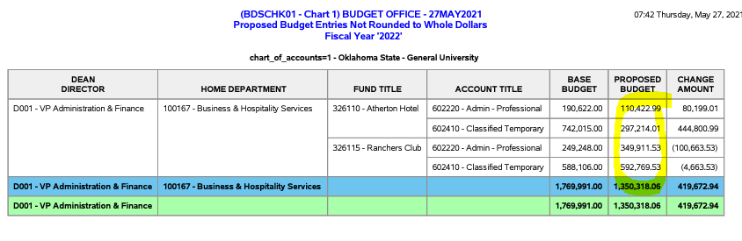
FI_BD_BDSCHK01_X (X represents Chart)
Budget Not Whole Dollars
Proposed budget entries not rounded to whole dollars. These entries must be corrected.

Slide 29
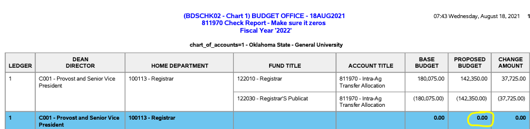
FI_BD_BDSCHK02_X
811970 Check Report
Non-zero budget entries in 811970. Must have an offsetting entry if budgeting this account code, whether between funds within your area, or between your fund and one belonging to another department.

Slide 30
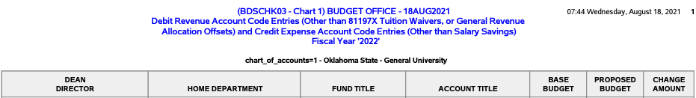
FI_BD_BDSCHK03_X
Debit Revenue Accounts & Credit Expense Accounts
Revenue account codes with debit entries or expense account codes with credit entries. This is an advisory report…entries may be correct.

Slide 31
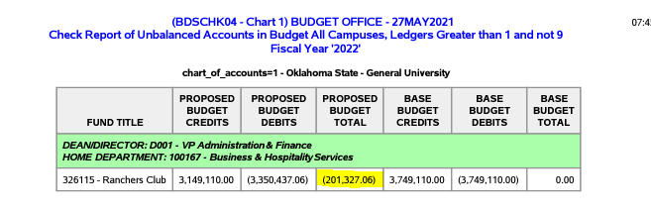
FI_BD_BDSCHK04_X
Out of Balance – Ledger 2 & Ledger 3
Ledger 2 or ledger 3 funds out of balance (proposed budget total should net zero). These entries must be corrected.

Slide 32
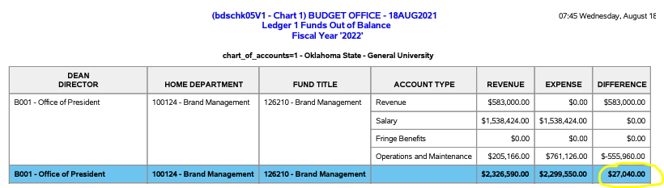
FI_BD_BDSCHK05_V1_X
Out of Balance – Ledger 1
Ledger 1 funds out of balance. These entries must be corrected.

Slide 33
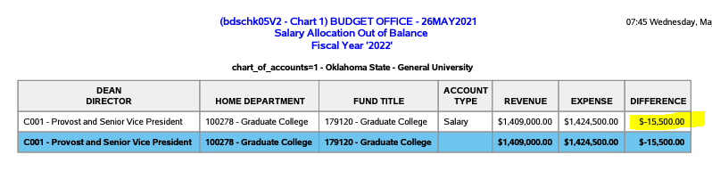
FI_BD_BDSCHK05_V2_X (Chart 1 only)
Out of Balance – Salary Allocation
Salary allocation out of balance. The total of all salary account codes (602000-60248X) must equal the amount for 811992. These entries must be corrected.

Slide 34
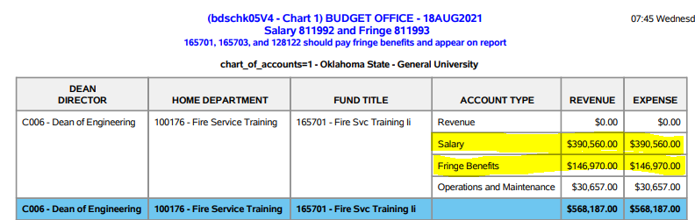
FI_BD_BDSCHK05_V4_X (for Chart 1 only)
Proposed Budget in 811992 and 811993 Account Codes
If budget in 811992, then 811993 should be zero. These entries must be corrected.*
*Exceptions are noted within the report header.
Exceptions

Slide 35
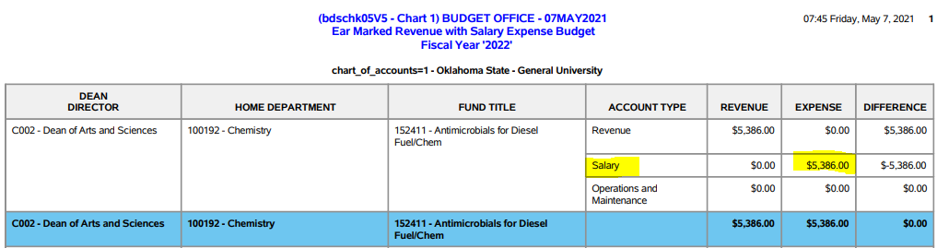
FI_BD_BDSCHK05_V5_X (Chart 1 only)
Earmarked Revenue with Salary Expense Budget
Earmarked revenue funds with salary expense budget must have fringe benefits expense budget. These entries must be corrected.

Slide 36
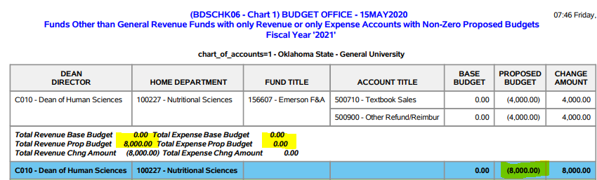
FI_BD_BDSCHK06_X
Only Revenue or Only Expense Budget
Funds with only revenue or only expense budget entries….must have both revenue and expense account entries netting to zero. These entries must be corrected.

Slide 37
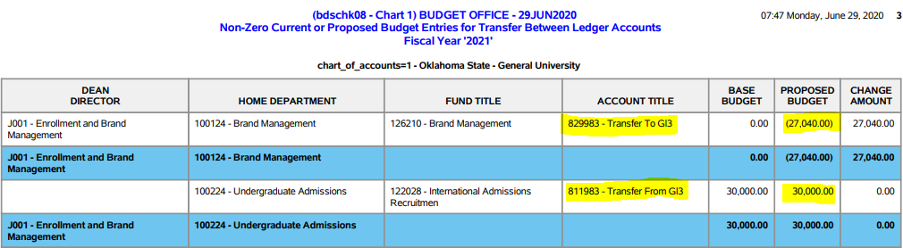
FI_BD_BDSCHK08_X
Non-Zero Budget – Transfers Between Ledger Funds
Non-zero budget entries for transfers between ledger funds. This is an advisory report.

Slide 38
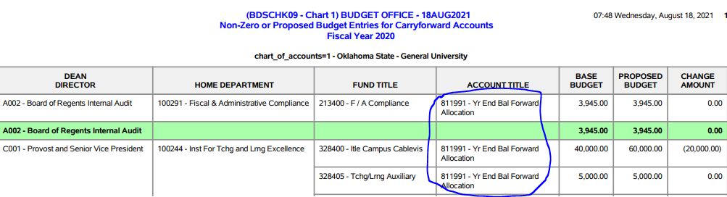
FI_BD_BDSCHK09_X
Non-Zero Budget – Carryforward Accounts
Non-zero budget entries for carryforward account codes. Entries for ledger 1 funds are not allowed and must be corrected (Chart 1 only).

Slide 39
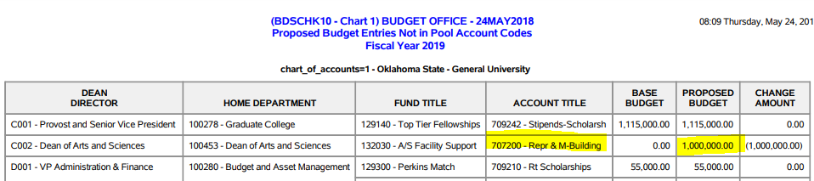
FI_BD_BDSCHK10_X
Budget Not in Pool Account Codes
Expense budget entries not in pool account codes. These entries must be corrected.*
*Exception – scholarship and debt service account codes

Slide 40
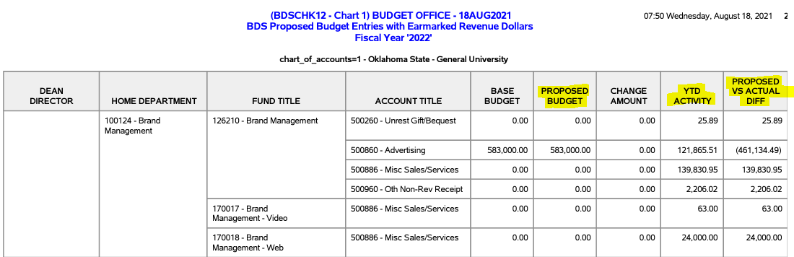
FI_BD_BDSCHK12_X
Proposed Budget with Earmarked Revenue Accounts
Budget entries with earmarked revenue dollars. The report compares the Proposed Budget to the YTD Activity. This is an advisory report.

Slide 41
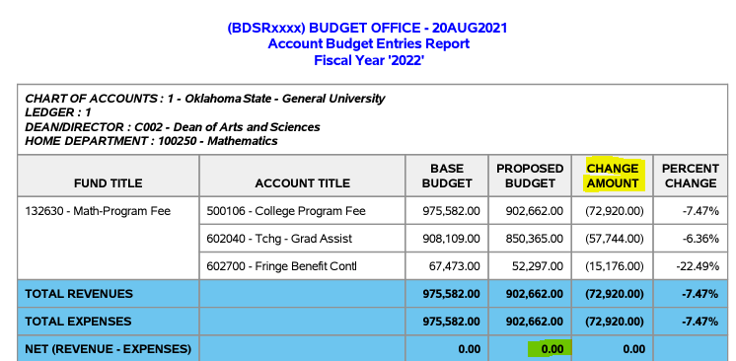
FI_BD_BDSR_X (example with changes)
Compares Base Budget to Proposed Budget
Shows the Base Budget (initial budget loaded into Budget Development) compared to the Proposed Budget (what will be loaded for next fiscal year).

Slide 42
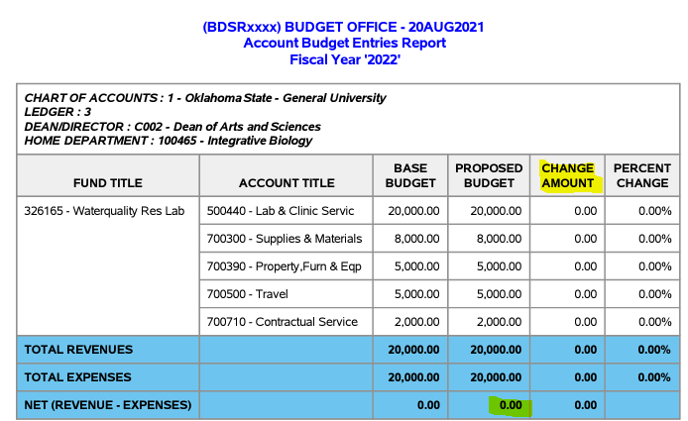
FI_BD_BDSR_X (example with no changes)
Compares Base Budget to Proposed Budget
Shows the Base Budget (initial budget loaded into Budget Development) compared to the Proposed Budget (what will be loaded for next fiscal year).

Slide 43
Reminders
Enter the amount of change to the Base Budget.
Budget expenses (70% account codes) in budget pools only.
The minus “-” must be in front of the amount keyed if reducing a budget.
Budget in whole dollars; NO cents.
811xxx accounts are Revenue; 82xxxx accounts are Expenses.

Slide 44
Reminders
FOR CHART 1 ONLY: Carryforward (811991) cannot be budgeted on
ledger 1 (1XXXXX) funds. You can, however, budget expected
carryforward on ledger 2 and ledger 3 funds.
If establishing budget in a new fund, you will need to know the Program Code before adding the Account lines.
When adding new Account lines on any fund, make sure Budget Duration Code is PERMANENT BUDGET.

Slide 45
Reminders
Click Post after keying changes so Proposed Budget is updated; this is what will be uploaded for the new fiscal year. Any changes you may have entered may be lost when exiting the worksheet if you do not select Post. Pressing Enter will change New Budget but will not update Proposed Budget.
Do not use the Delete Record column. If an account code will not be budgeted for next fiscal year, change the value so the Proposed Budget equals zero.
If there has been an organization change on a fund, the Base Budget will appear in the old org and will need to be zeroed, and the new Fiscal Year Proposed Budget will need to be entered for the new org.

Slide 46
If you have questions,
please email us at
sysbdgt@okstate.edu

