Slide 1




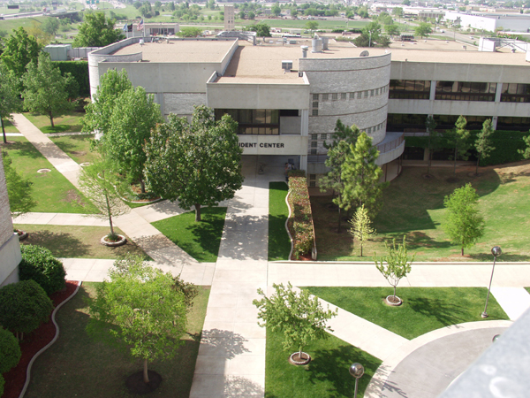
FY 2010 Budget

Slide 2

FY 2010 Budget Presentation
OSU FY 2010 Budget:
  Changes In Funding
    State Appropriations
    ARRA (American Recovery & Reinvestment Act)
  Source and Use of Funding
  No Requested Increases in Tuition and/or Mandatory Fees
  (1st time in more than 10 years)
  Proposed FY 2010 Budget For OSU Agencies
  Future Considerations
  Highlights

Slide 3
American Recovery & Reinvestment Act (ARRA) Stimulus Funding
  Funding is targeted to be spent by Fall 2009.
  Funds will be applied to faculty and/or staff salaries.
  Institutions are required to demonstrate accountability regarding the use of ARRA funds.
    Using funds for salary expenditures will help simplify tracking and reporting.
    Ms. Rita Hesser will serve as the certification officer and will be responsible for monitoring OSU funds.

Slide 4
ARRA Funding Is Expected To Be Available Through FY 2011
With the nationwide trend of decreasing state support, institutions must rely on tuition and fee revenue which is increased in one of three ways:
Increase the number of new students entering the university
2. Improve retention rates of students already attending the institution
3. Increase tuition and mandatory fee rates

Slide 5
FY 2010 State Allocations to OSU Agencies

Slide 6
Sources of New Revenue
* Other includes reallocations and endowment earnings.

Slide 7
Use of New Funds

Slide 8
Sources of Revenue for All OSU Agencies
FY 2009 FY 2010
Total Budget = $938.6M
Total Budget = $964.2M

Slide 9
FY 2010 Proposed Budget for Approval
OSU Agencies
*The decrease in sponsored programs is due predominately to the following:
OSU-CHS moving medical residents from CHS payroll to be paid directly from the hospital ($5.5M)
OSU-CVHS loss of faculty with established grants, replaced with new faculty getting established
and applying for grants ($4.0M)

Slide 10
Oklahoma State University
System Enrollment

Slide 11
Future Considerations
FY 2010 Budgets For OSU Agencies Are Very Conservative And Cautious Regarding Long-Term Commitments
  Fiscal Environment
    Economic Uncertainty
    Future Enrollment Patterns
    Statewide Ballot on Common Education
  Budget Initiatives
    Budget Savings Task Force
    Additional Administrative Budget Reductions
    Implementation of Targeted Strategies to Increase Enrollment
    Continue to Build General University Reserves

Slide 12
General University Highlights
Enrollment Management:
$1,475,000 increase for new freshmen and undergraduate transfer waivers. This, in addition to new positions for recruiters, has contributed to upswings in both applications and admitted students.
Graduate College:
$250,000 increase for graduate assistant stipends. This improves the quality of graduate recruitment, which in turn assists faculty in teaching and research.
Institution for Teaching & Learning Excellence (ITLE) Upgrade:
$366,666 for digital upgrade. This will allow distance learning courses to be delivered in a higher digital quality.
Contributes to future growth in undergraduate enrollment
Contributes to future growth in graduate enrollment
Contributes to future growth in offering distance learning and online courses

Slide 13


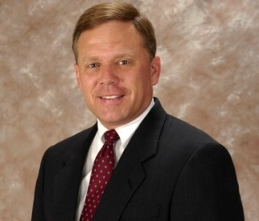
New Endowed Chairs
Spears School of Business
Dr. Michael Morris is a recognized entrepreneurship scholar and educator who has published more than 100 peer-reviewed articles and seven books, and was named one of the Top Entrepreneurship Professors in the country by Fortune Small Business. He has been a principal in three entrepreneurial ventures and has taught entrepreneurship around the world. A former Fulbright Scholar, he has received numerous honors including the Outstanding Faculty Award from Syracuse University’s MBA class in 2004, 2006 and 2007, the Oberwager Prize for impacting students beyond the classroom, and the Appel Prize for Contributions to Entrepreneurship.
Nola Miyasaki was formerly the Executive Director of Entrepreneurial Programs at Syracuse University, responsible for cross-campus and community initiatives. Among other programs, she launched a Women’s Business Center, a community test kitchen, and a program for disabled entrepreneurs as part of an inner-city incubator. Her experience includes serving as CEO of the State of Hawaii’s technology development corporation, vice president of a tissue engineering start-up, launching a sports marketing venture and working in corporate law. She was honored most recently with the 2008 Women in Business Champion Award by the Small Business Administration, the 2007 Women’s Leadership Award by Syracuse University, and a 2005 Technology Industry Award for her contribution to technology in the State of Hawaii.
Dr. Bruce Barringer was formerly an associate professor at the University of Central Florida, where he has taught Strategic Management, Entrepreneurship, and Principles of Management. Dr. Barringer has received numerous awards for research, publications and teaching, including the Research Incentive Award at the University of Central Florida, Distinguished Paper Awards from Southwestern Small Business Institute Association Annual Meeting and the Southwest Academy of Management Annual Meeting, Teaching Incentive Performance Award and Galloway Graduate Teaching Award from the University of Central Florida.
Mitchell Chair
Stevenson Chair
Pope Chair

Slide 14
Additional Agency Highlights
Division of Agricultural Sciences & Natural Resources
Requesting $4.5M in ARRA funding for biofuels project. Presently waiting final approval from the U.S. Department of Energy.
Hired 35 new faculty to expand interdisciplinary research and extension capabilities. New faculty hires were made possible by Second Century Initiative funding of $5.4M.
Completing infrastructure for the 2,500 acre Mac Lindley Research and Demonstration Farm in McCurtain County.
OSU-Center for Veterinary Health Sciences
Established the National Center for Veterinary Parasitology, funded by private contributions. The newly formed center will focus on the advanced training of veterinarians in parasitology.
Implemented the Early Admissions Program to aid students with strong academic ability. Eligible applicants must have an ACT score of 27 or be in the top 10% of their graduating class.
Completed the renovations and additions to the Oklahoma Animal Disease Diagnostic Laboratory and the Small Animal Critical Care Unit (July 2009).

Slide 15
Additional Agency Highlights
OSU Institute of Technology-Okmulgee
In addition to not increasing costs of attendance (tuition, fee, room, and board rates), tuition waivers have been increased to help ease students’ financial burden.
Enrollment in the High Voltage Linesperson Program has grown over 70%.
Started a new Corporate Technician Training Program with Aggreko North America and Manitowoc Crane.
OSU-Oklahoma City
Increased budget for faculty salaries to support enrollment growth and new programs.
Strengthened student support services to improve retention and student success.
Invested in automation and various technologies to improve the efficiency of campus processes.

Slide 16
Additional Agency Highlights
OSU-Center for Health Sciences
OSU Physicians Practice projected to exceed $20 million in gross revenue for FY 2010.
Construction of the joint OSU-CHS/Tulsa Police Department Forensic Sciences and Biomedical Research Facility is on track for a November 2010 completion.
FY 2010 begins the incremental growth in medical school admissions from 88 to 115 students per year.
OSU-Tulsa
An agreement was completed with the OETA to bring their new Tulsa studio to the OSU-Tulsa campus.
In conjunction with the College of Human Environmental Sciences, the Center for Family Risk & Resilience was established at OSU-Tulsa.
A communications disorder clinic was created in partnership with the College of Arts & Sciences.

Slide 17


